Slide 1
Build x : android
Lecture One: Layouts & Views

Slide 2
Recap

Slide 3
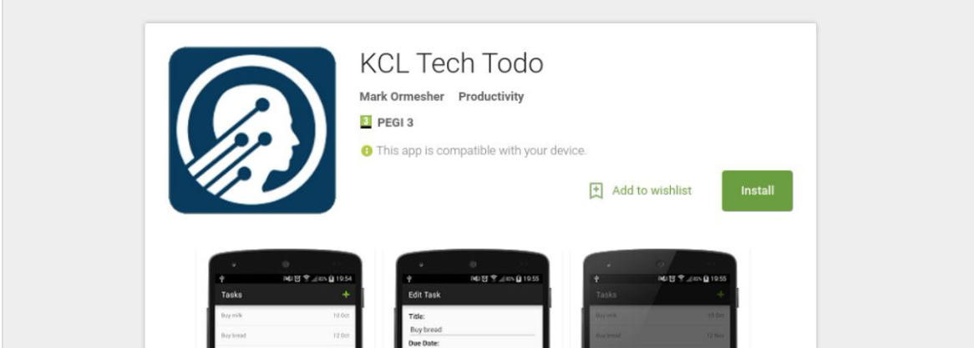
Recap – What are we doing?
We’re going to build a basic todo list app, KCL Tech Todo.
If you want a preview, it is available on Google Play.
Search for ”KCL Tech Todo” on Google or on the Play Store.

Slide 4
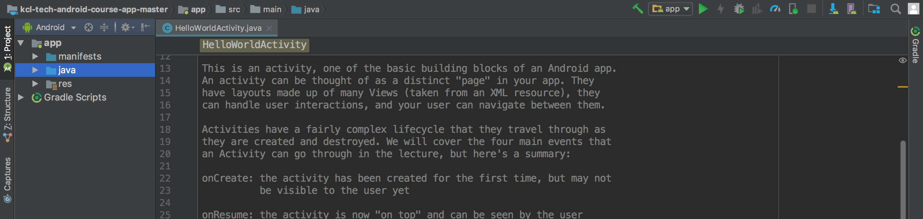
Recap – Environment Setup
You should have Android Studio installed on your machine.
You should have the blank project downloaded (https://tinyurl.com/android-blank-project)
You should be able to run the blank project on your phone or on your emulator

Slide 5
Recap – Components of an Android App
Activities – a page in your app. This is a Java class.
These have a complex “create, resume, pause, stop” lifecycle.
Resources - files to store values that your app relies on. These are XML files.
Strings, dimensions, colours, layouts, styles, etc.
Layouts – a specific type of resource. This is an XML file.
These describe the structure and appearance of your app.
AndroidManifest.xml – a spec-sheet for your app
Describe what your app needs, what it contains, and what it can do.

Slide 6
Layouts
A layout is an XML resource file that tells the device about the structure and appearance of sections of your app.
“Put this here, now put that there, and put this next to that, etc…”
Q: How do we know which layout to use for which activity?
Hint: One line of code…

Slide 7
O Layouts! Wherefore art thou?
All layouts live in one folder:
/app/res/layout
We tell Android which layout to use for a certain activity by adding one line:
setContentView(R.layout.activity_hello_world);
What’s going on here?

Slide 8
O Layouts! Wherefore art thou?
setContentView(R.layout.activity_hello_world);
setContentView(
R.
layout.
activity_hello_world
);
We’re setting the view
for this activity.
We want a
resource…
…it’s a
layout…
…and this is it’s name.
Done!

Slide 9


Slide 10
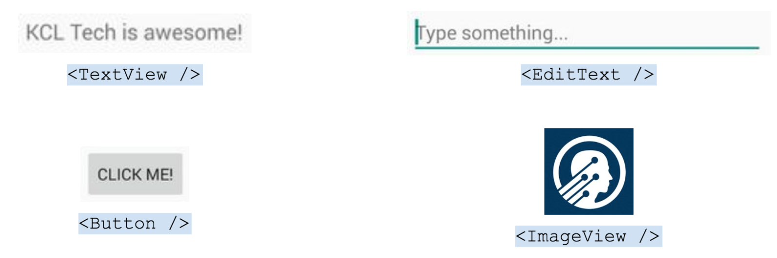
Parts of a Layout: Views
A layout will usually contain many views.
Views are added to a layout in their XML files.

Slide 11
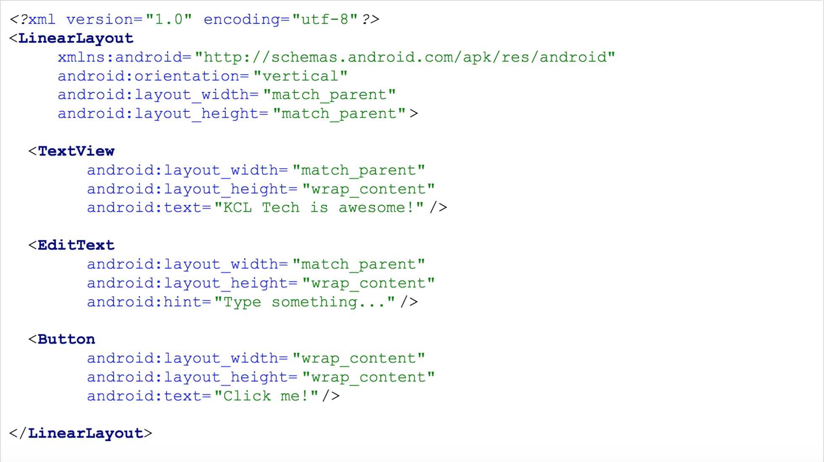
What is this?
Text View
Edit Text View
Button View

Slide 12
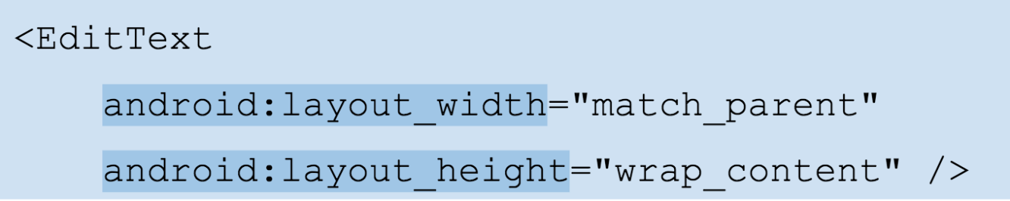
View Attributes
These two attributes are required on every view.
There are others, like android:text, android:padding, android:visibility, etc.
These attributes define everything about your view.
These define the height and width of the view. You can use a number of pixels here, or another
measurement that Android supports (more later).
But what are “match_parent” and “wrap_content”?

Slide 13
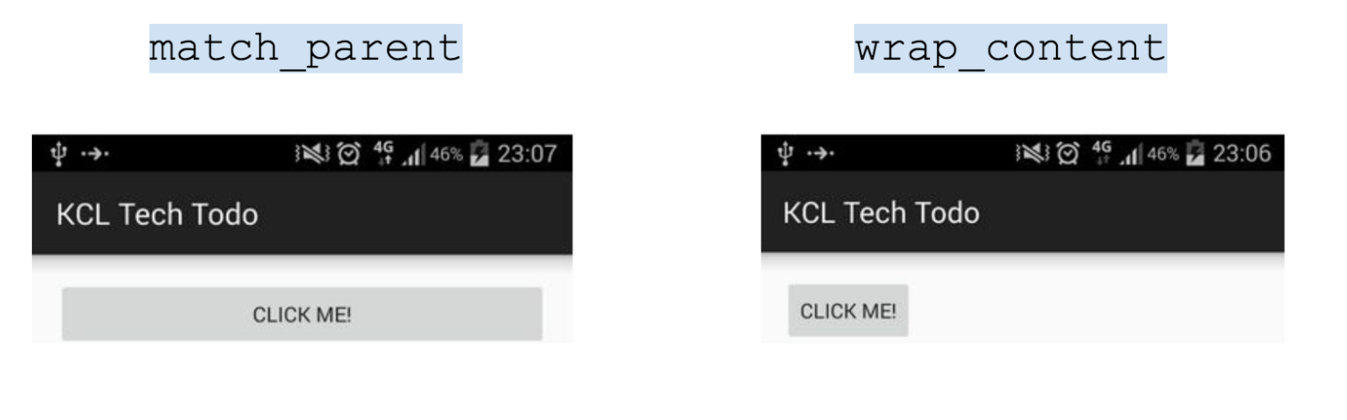
View Attributes
Both can be used for width or height, and you can use them in any combination.
match_parent: make this view as wide/tall as the view surrounding it.
wrap_content: make this view just wide/tall enough to show what it contains, but no more.

Slide 14
What is this?
Also a view!

Slide 15
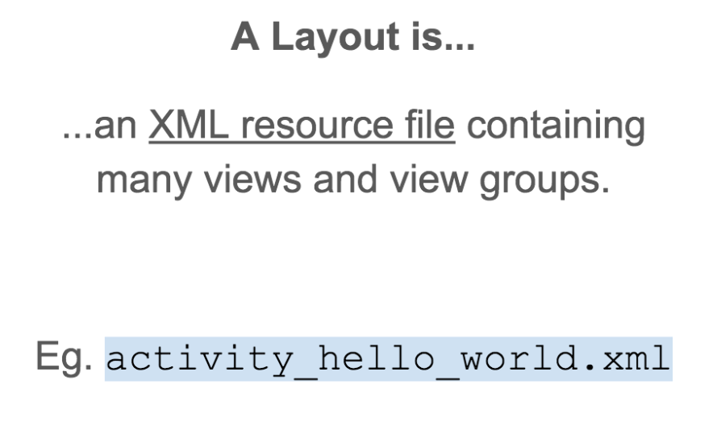
//Side Note: Stupid Names
LinearLayout is an example of a View Group, which we’ll get to in a bit. But just to give some clarity:
LinearLayout is a special type
of View, which is part of a Layout
resource file.

Slide 16
Now You Try! You have 10 minutes.
Update your “Hello world” layout to include a TextView, EditText and Button.
You’ll have to use the tag names mentioned above, the two attributes mentioned, as well as the
android:text attribute for TextViews and Buttons, and the android:hint attribute if you want
a prompt for your EditText.

Slide 17
Parts of a Layout: View Groups
Some special views can contain other views – these are called View Groups.
The views inside a view group are called it’s children.
The view group containing views is the parent of those views.
You cannot see a view group, only it’s children views inside it.

Slide 19
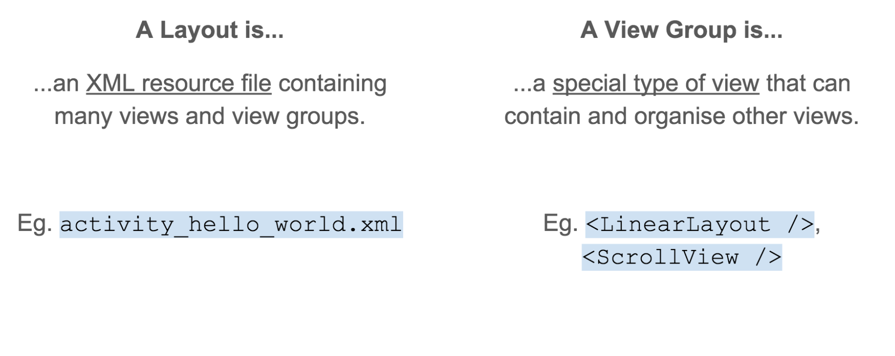
//Side Note: Stupid Names

Slide 20
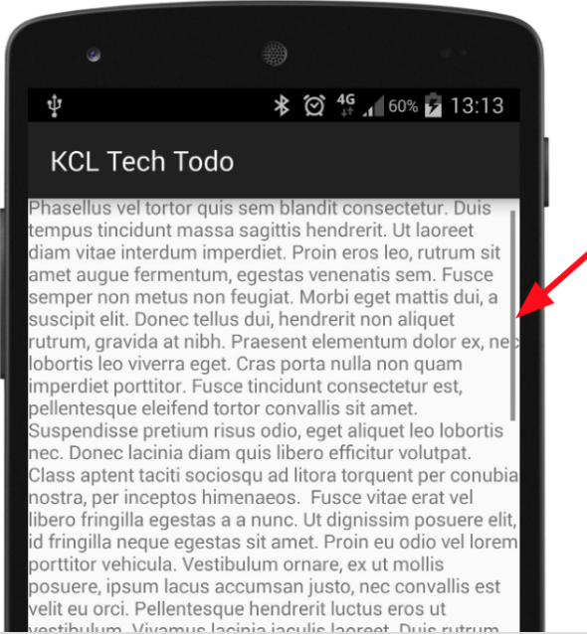
<ScrollView />
The simplest View Group that exists!
Has only one child (often another View Group)
Adds a scrollbar if it gets too tall/wide
That’s it.

Slide 21
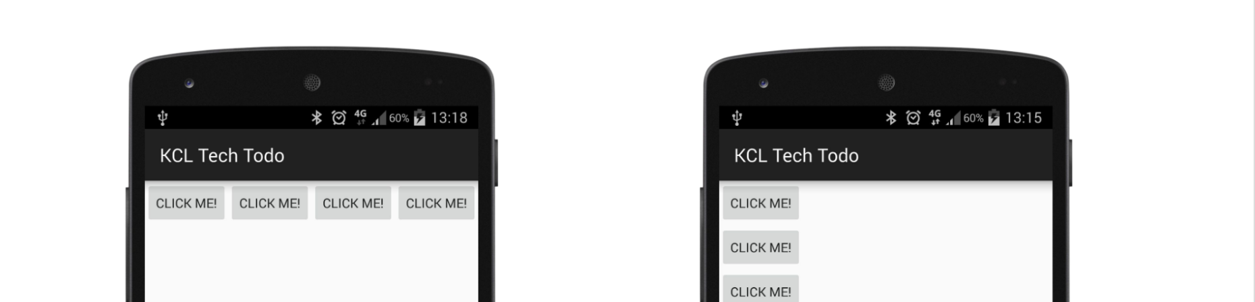
<LinearLayout />
Does one thing: stack views.
Accepts many children.
Stacks children horizontally or vertically.
Specified by android:orientation attribute.

Slide 22
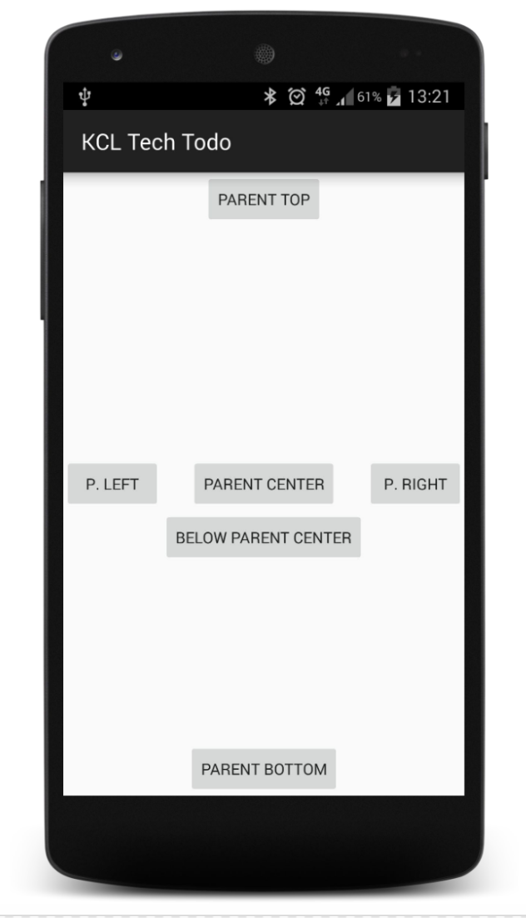
<RelativeLayout />
A step up in complexity.
Let’s you specify structures like:
“put this view to the left of that view,
put this view underneath this view;
make this view line up with the right edge of
another, etc…”
Accepts many children
Positions children relative to each other, or the parent.

Slide 23
Parts of a Layout: Other Resources
Resources we’re going to use live in this folder:
/app/res/values
Specifically:
Strings – /app/res/values/strings.xml
Dimensions - /app/res/values/dimens.xml
Styles - /app/res/values/styles.xml

Slide 24
Using String Resources
In the strings.xml file:
<string name=“hello_world”>Hello World!</string>
In the layout:
<TextView
...
android:text=“@string/hello_world” />

Slide 25
Using Dimension Resources
Density-independent
pixels
In the dimens.xml file:
<dimen name=“hello_world_height”>24dp</dimen>
In the layout:
<TextView
...
android:layout_height=“@dimen/hello_world_height” />

Slide 26
Using Style Resources
In the styles.xml
<style name=“hello_world_text”
<item name=“android:textStyle”>bold</item>
<item name=“android:textColor”>#00ff00</item>
<item name=“android:textSize”>18sp</item>
</style>

Slide 27
Using Style Resources
In the layout:
<TextView
...
style=“@style/hello_world_text” />

Slide 28
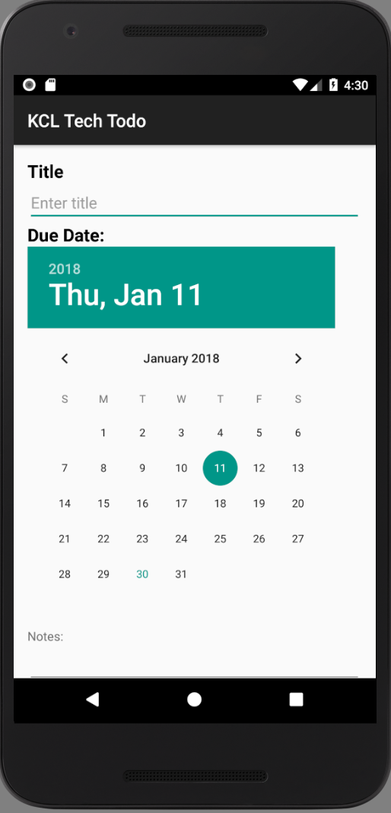
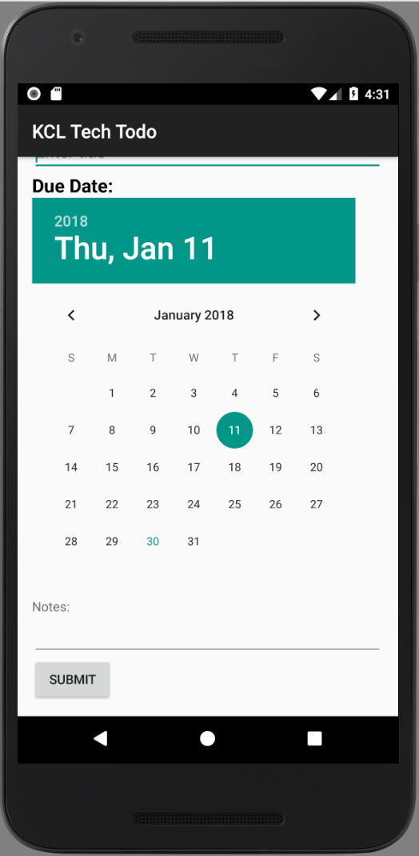
Now You Try!
Try to build this layout.
You have 40 minutes

